Slide 1
BarDown Coaching
Benjamin Keunen, Matthew Wong

Slide 2
Concept
Discussion of hockey and the teams and players that surround the sport often lead to “What if” discussions
In these discussions, it is often hard to keep track of all the moving parts, so we created an application to facilitate these ideas and be able to put numbers on paper

Slide 3
Features
Players Compendium
Contains information about players in a format that is comprehensible but not cluttered
Create and delete players for theoretical situations
Drills
Allows for user to illustrate a plan for players to follow or hypothesize about
Store these plans by name and quickly retrieve without hassle
Plan Team
Gives options for different lineups
Allow different loadouts for lineups
Create and delete different lineups
News
Stay up to date with the current happenings in the hockey world with the news sidebar

Slide 4
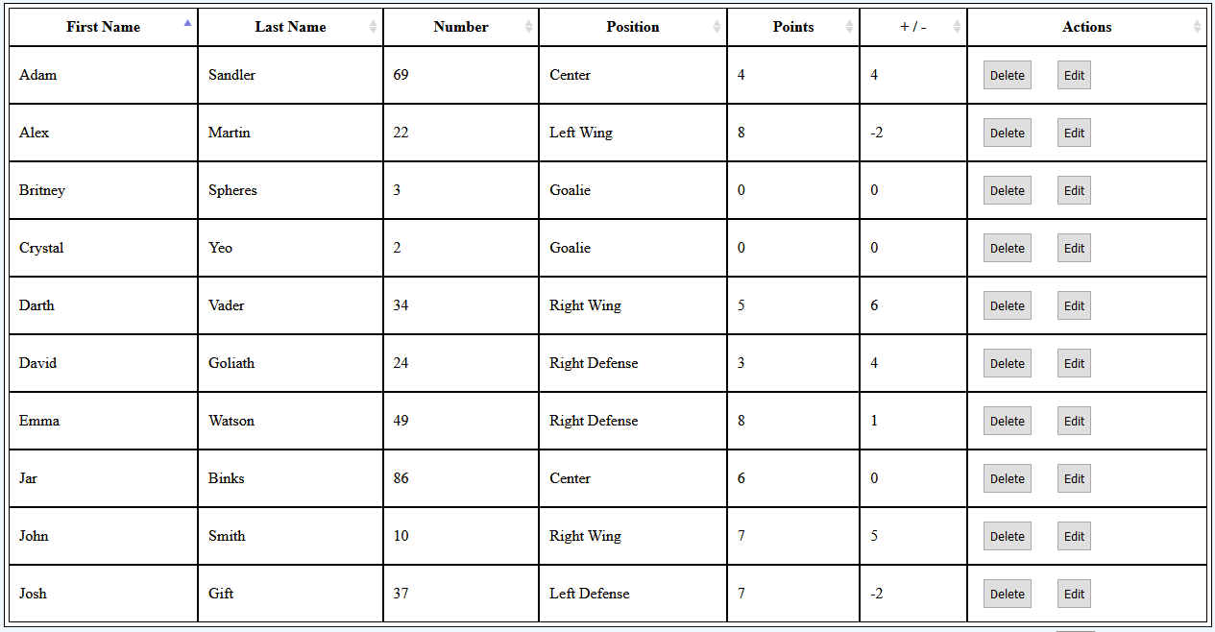
Players Compendium
This is a compilation of the players that are registered to your account on the database
Features statistics on players in a table and critical information
Allows the user to create, edit, or delete players from their roster

Slide 5
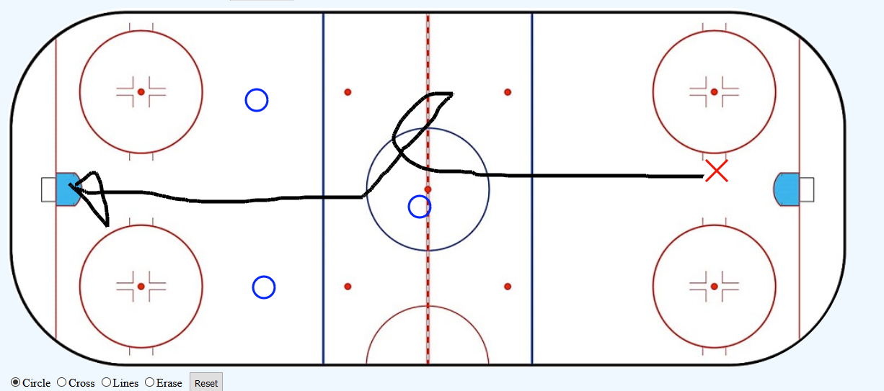
Drills
Features an on-screen rink that the user can draw on
Save and retrieve drawings to/from the database
Tools:
Circle allows the user to place red circle markers on the rink
Cross functions similar to circle, but uses red crosses
Lines allows the user to draw black lines on the rink
Eraser erases anything around the cursor in a certain radius
Table for drills allows user to view name and description of previously stored plans

Slide 6
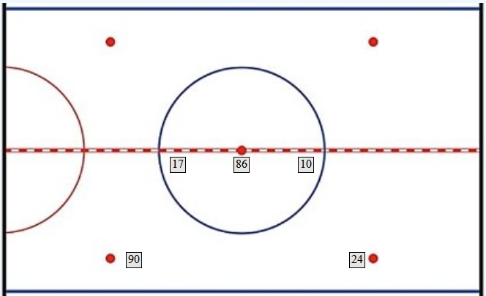
Plan Team
The User can visualize exactly where the players will be lined up
Have the ability to generate specific lines, Power, Defense, or Offense focused so the coach can stay up to date on who is best in each position for each situation.
Allows coach to create his own line such as planning out for injuries or unforeseen situations like penalties.

Slide 7

Summary
This website help coaches do what is best for their teams, being able to plan from the beginning of practice to the end of the game sets the team up for success and allows them to reach their full potential.

